Slide 1
Technical Lessons Learned with DKV
You don’t have to agree..

Slide 2
Practices
...should drive the tools

Slide 3
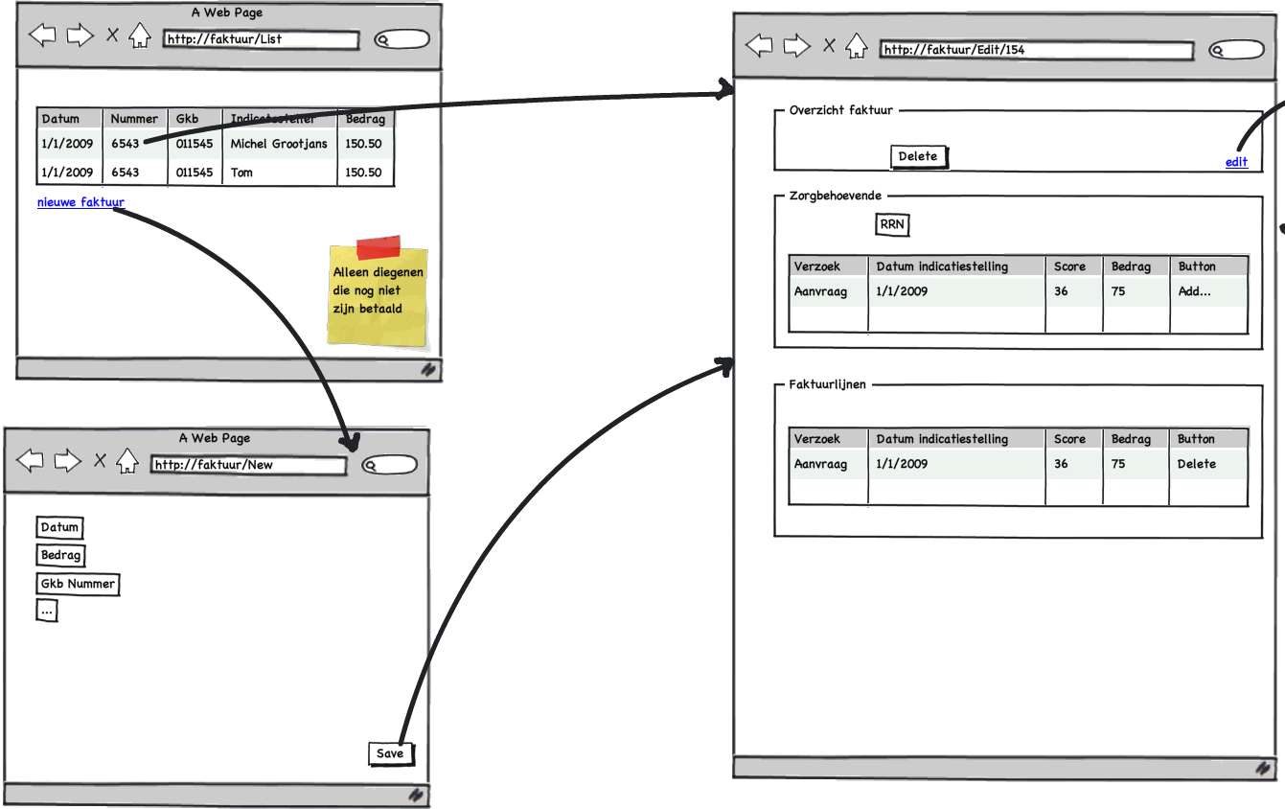
Practices: Top-down design

Slide 4
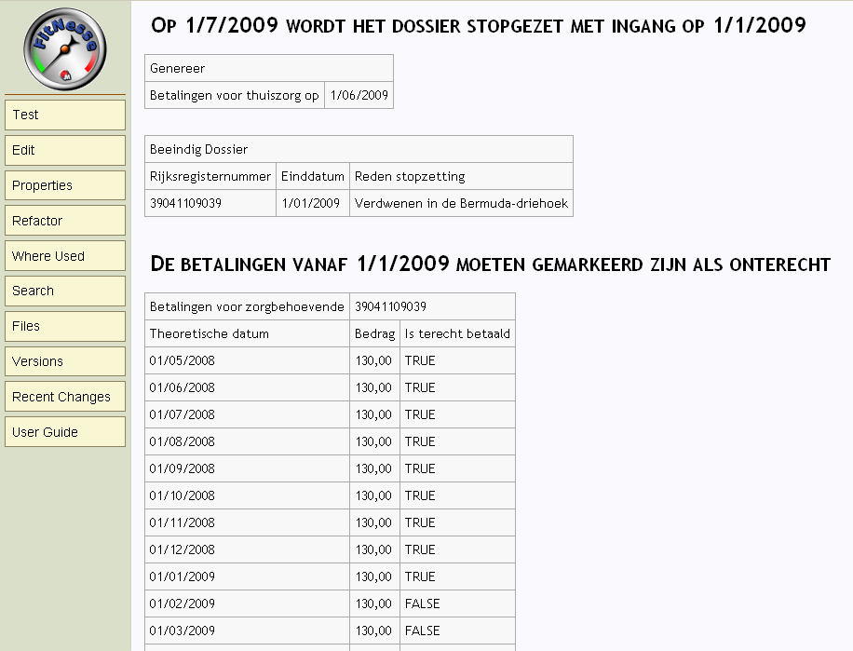
Practices: Specification by example

Slide 5
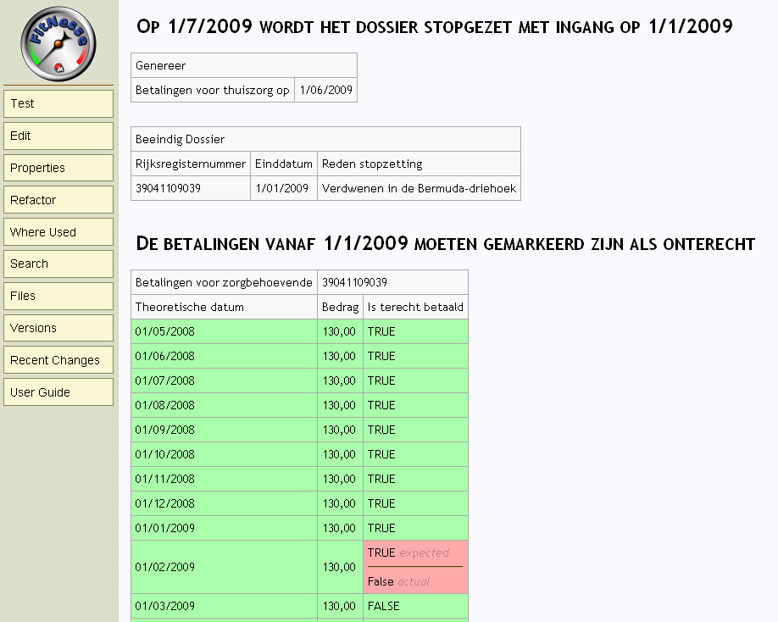
Practices: Specification by example

Slide 6
Practices: Test Driven DESIGN
Select a new feature to implement
Do we have a test for that?
NO
Write a test
YES
Does the test pass?
NO
Write just enough code to make the test pass
YES
Need to refactor?
YES
Refactor the code
NO

Slide 7

Practices: Pair Programming

Slide 8
Practices: Readability
if (attest.Datum.IsInTheFuture())
{ //...}
if (attest.Datum.IsBetween(1.Januari(2009), 31.December(2009)))
{ //...}
When(repository)
.IsToldTo(r => r.Get<Zorgbehoevende>(zorgbehoevendeId))
.Return(zorgbehoevende);

Slide 9
Architecture
We’ll try not to make this boring

Slide 10
Application flow
Controller
View
GET Request
request
Mapper
Dto
Service
Repository
Entity
data
DB

Slide 11
UI
The only thing the user sees

Slide 12
UI: Microsoft’s MVC
Model
View
Controller
public class ZorgbehoevendeController : Controller
{
public ActionResult Detail(string id)
{
var zorgbehoevende = zorgbehoevendeService.GetZorgbehoevende(id);
return View(zorgbehoevende);
}
public ActionResult Create(CreateZorgbehoevendeDto dto)
{
var id = zorgbehoevendeService.CreateZorgbehoevende(dto);
return RedirectToAction("Detail", id.ToIdRoute());
}
}

Slide 13
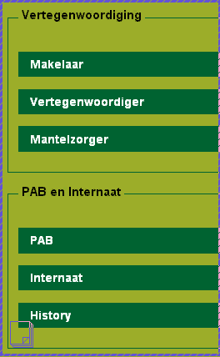
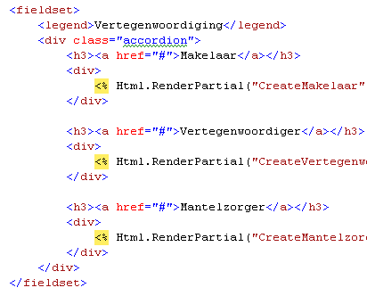
UI: jQuery
Script
View

Slide 14
Domain
... where the intelligence SHOULD be

Slide 15
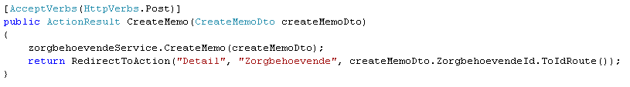

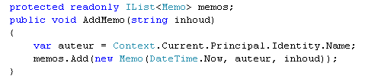
Domain Driven Design
Controller
Service
Entity

Slide 16
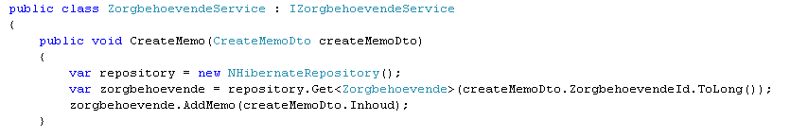
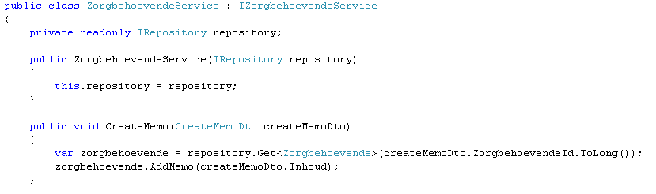
Domain: Loose coupling
Dependency
Service
Dependency Injection
Service

Slide 17
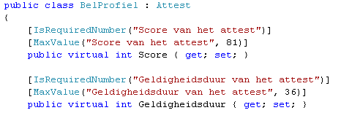
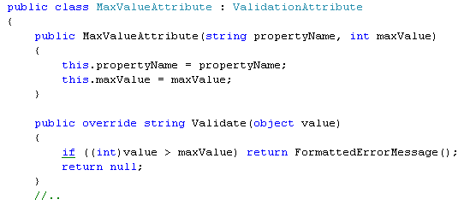
Domain: Validation with attributes
Service
Entity
Attribute

Slide 18
Domain: Mapping
Entity
public class Memo : Entity
{
public Memo(DateTime date, string auteur, string inhoud)
{
Datum = date;
Auteur = auteur;
Inhoud = inhoud;
}
public DateTime Datum { get; protected set; }
public string Auteur { get; protected set; }
public string Inhoud { get; protected set; }}
Dto
public class ViewMemoDto
{
public string Datum { get; set; }
public string Auteur { get; set; }
public string Inhoud { get; set; }
}
Service
var memos = Map.These(user.Memos).ToAListOf<ViewMemoDto>();
Application Startup
Mapper.CreateMap<Memo, ViewMemoDto>();
Mapper.CreateMap<DateTime, string>()
.ConvertUsing(d => d.ToScreenDate());

Slide 19
Data
... a happy side effect

Slide 20
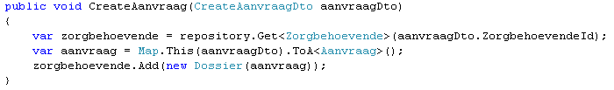
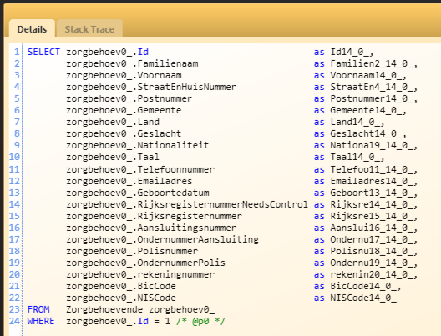
Data: Nhibernate
Service

Slide 21
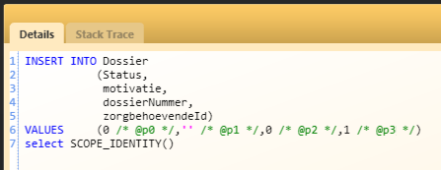
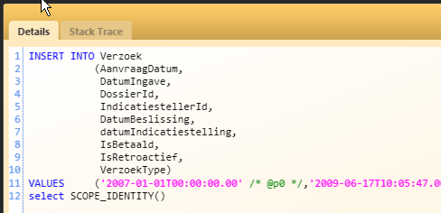
Data: Nhibernate
Service

Slide 22
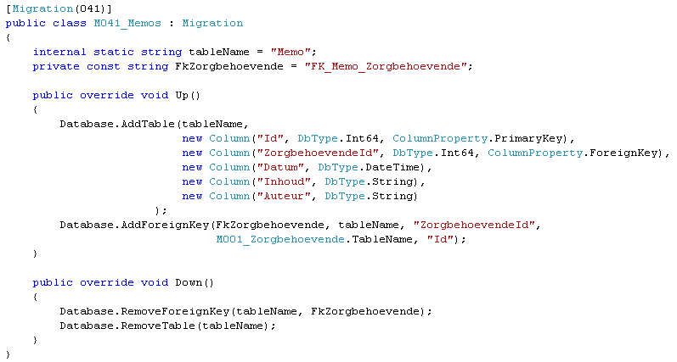
Data: Migrations
Migration

Slide 23
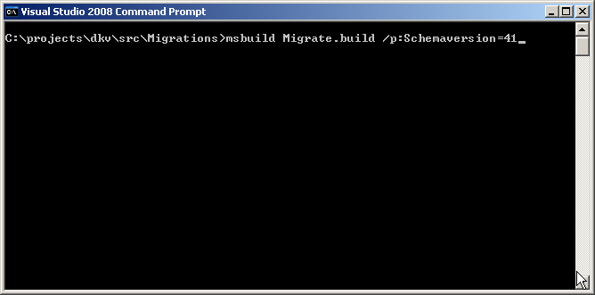
Data: Migrations
Migration

Slide 24
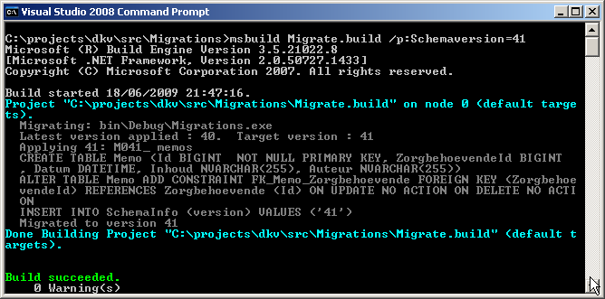
Data: Migrations
Migration

Slide 25

Data: Migrations
Migration

Slide 26
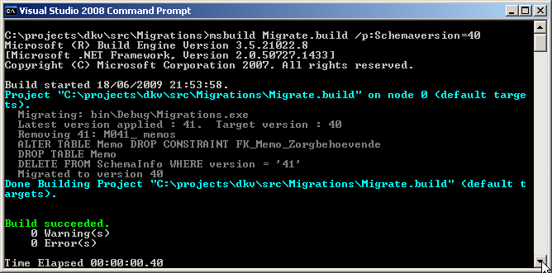
Data: Migrations
Migration

Slide 27
Data: Migrations
Migration

Slide 28
Testing
Building the system right

Slide 29
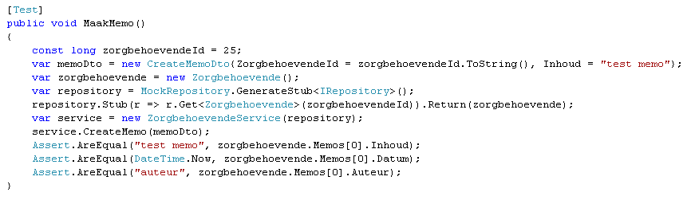

Unit Testing: Basic test
Easy to read
Easy to tell what is being tested
Easy to tell which test failed

Slide 30
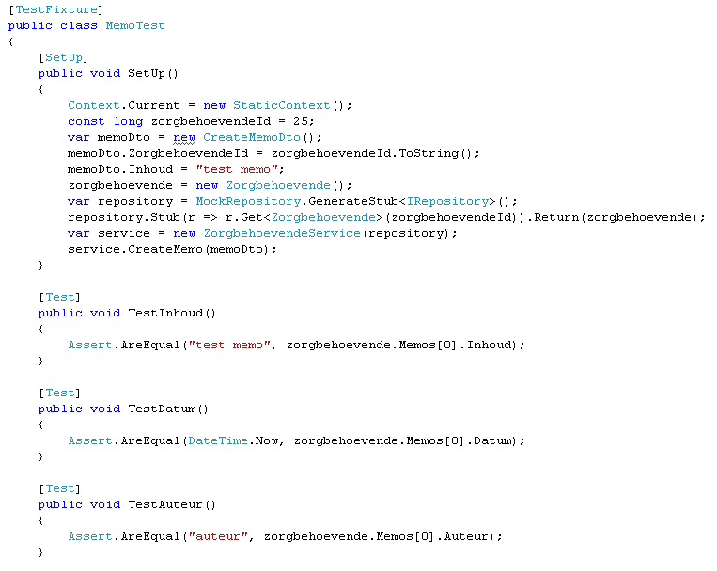

Unit Testing: Separating Tests
Easy to read
Easy to tell what is being tested
Easy to tell which test failed

Slide 31
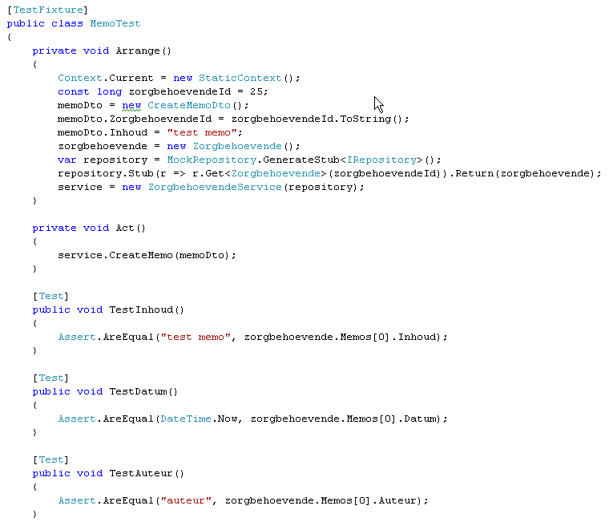

Unit Testing: Separating Execution
Easy to read
Easy to tell what is being tested
Easy to tell which test failed

Slide 32
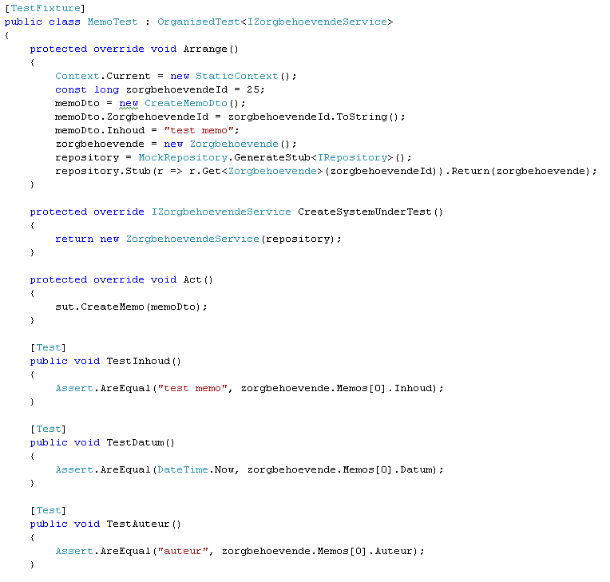
Unit Testing: Separating the SUT
Easy to read
Easy to tell what is being tested
Easy to tell which test failed

Slide 33

Unit Testing: Readability
Easy to read
Easy to tell what is being tested
Easy to tell which test failed

Slide 34
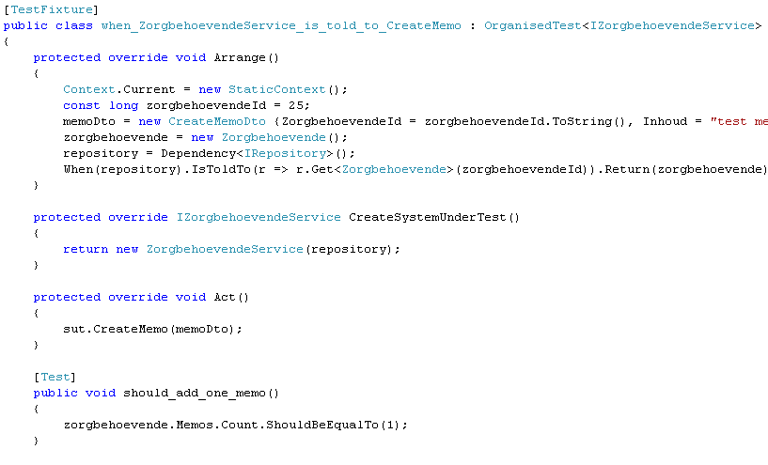
Unit Testing: Structure
Arrange
Act
Assert

Slide 35
Application Lifecycle Management
Lightweight tools that don’t get in the way

Slide 36
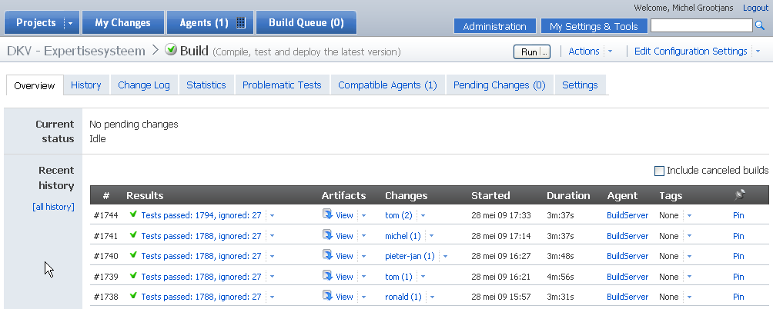
TeamCity: Overview

Slide 37
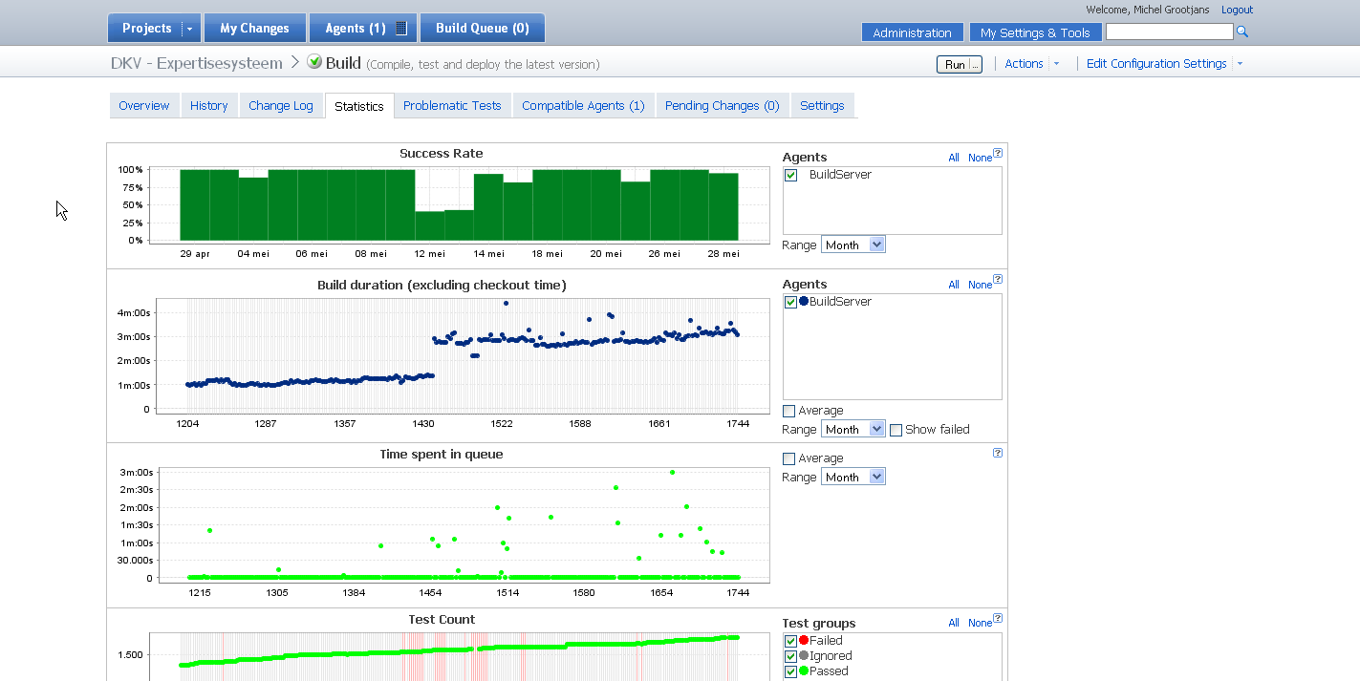
TeamCity: Statistics

Slide 38
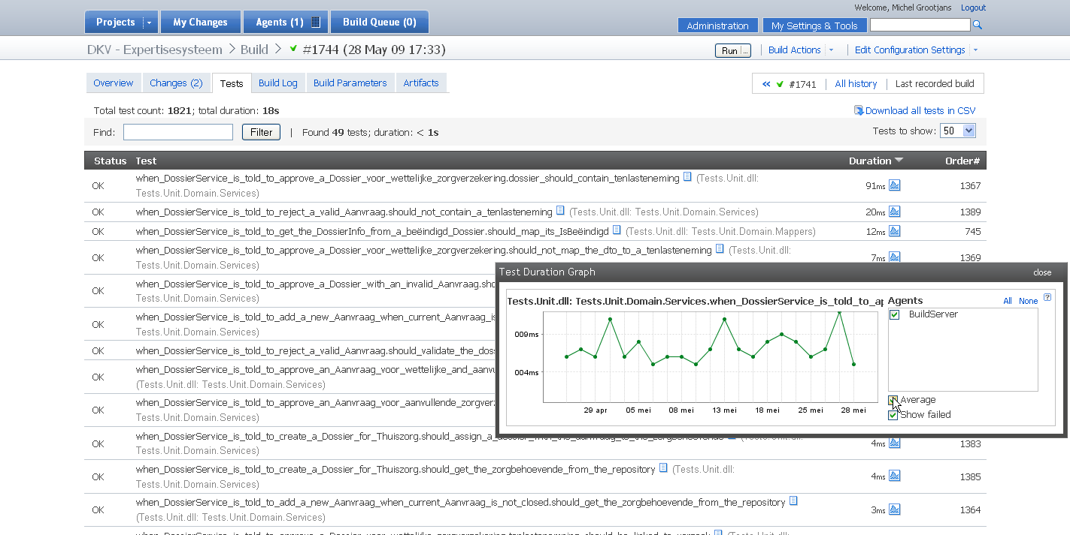
TeamCity: Test details

Slide 39
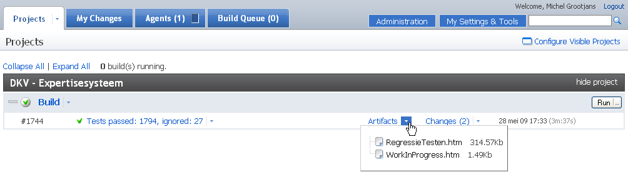
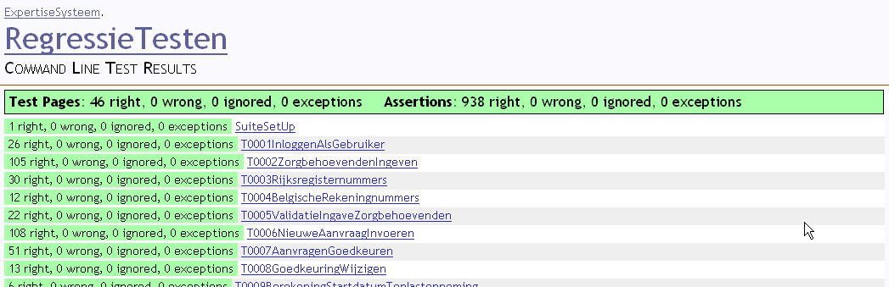
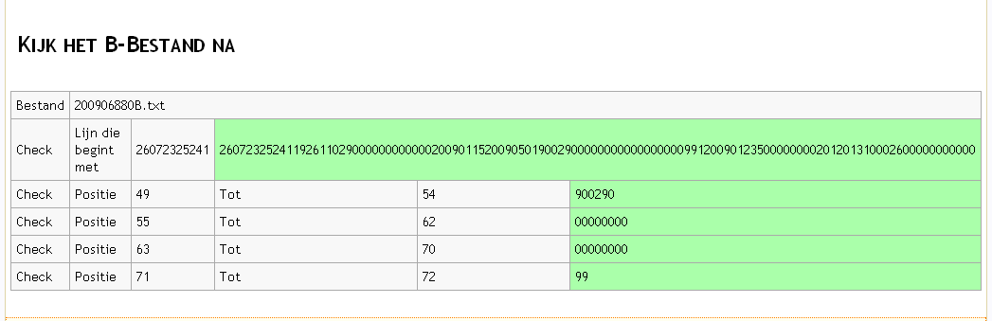
TeamCity: Artifacts

Slide 40
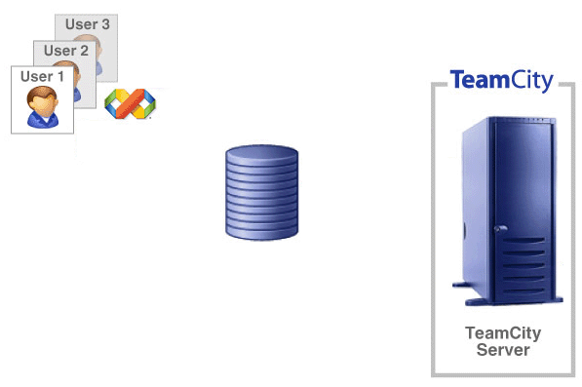
ALM: Traditional approach
Edit
Commit
Verify
SVN

Slide 41
ALM: TeamCity with Subversion - A Perfect match!
Edit
Verify
Commit
SVN

